Slide 1


Michael Feranda
03/13/2024

Slide 2

Outline
Executive Summary
Introduction
Methodology
Results
Conclusion
Appendix

Slide 3
Executive Summary
In this project, we will predict if the SpaceX Falcon 9 first stage will land successfully.
Methodologies:
Automated API Data Extraction
Modular Data Processing
Data Refinement & Structuring
Targeted Feature Engineering
Summary of results
There is a correlation with the outcome of the launches.
Use of decision tree may be the best method for prediction.

Slide 4
Introduction
Project background and context
SpaceX's reusable Falcon 9 rockets offer significant cost advantages in space launches. Understanding the factors that influence successful first-stage landings is crucial for competitive analysis and cost optimization.
Problems you want to find answers
We aim to predict Falcon 9 first-stage landing success. This will enable us to determine launch costs more accurately, providing a strategic advantage for alternative launch providers.

Slide 5

Section 1

Slide 6
Methodology
Executive Summary
Automated API Data Extraction:
Leveraged SpaceX's public API to gather comprehensive historical launch data.
Implemented structured functions to efficiently extract and organize data from various API endpoints.
Data Refinement & Structuring:
Utilized Pandas to transform raw data into a clean, structured DataFrame for analysis. Implemented error handling to increase data integrity.
Targeted Feature Engineering:
Focused on extracting and refining key variables relevant to Falcon 9 first-stage landing prediction with interactive visuals using Follium and Potly.
Machine learning prediction:
Logistic regression, Decision tree, K-nearest neighbors (KNN), Support vector machine (SVM)

Slide 7
Data Collection
Our data collection began with accessing the SpaceX public API, the primary source for historical launch information. Using Python's requests library, we systematically retrieved data from various endpoints, including launches, rockets, launchpads, payloads, and cores. This allowed us to build a comprehensive dataset encompassing launch date, rocket details, launch site coordinates, payload mass, and core landing outcomes.

Slide 8
Data Collection – SpaceX API
SpaceX data is gathered from the API as JSON.
This provides information about launches like rocket used, location data, payload, specifications, landing outcome.
Data Collection Jupyter File
SpaceX API
Returns SpaceX data as JSON
Save as CSV
Data
HTML Scrape
Data extract with Python
Save as CSV

Slide 9
Data Collection - Scraping
Data scraped from Wikipedia using BeautifulSoup
This provided information about launches like rocket used, location data, payload, specifications, landing outcome.
Data Collection Jupyter File
SpaceX API
Returns SpaceX data as JSON
Save as CSV
Data
HTML Scrape
Data extract with Python
Save as CSV

Slide 10
Data Wrangling
Loaded data using pandas, read_csv
Identify missing values and calculate percentages.
Check data types (numerical, categorical).
Analyze launch sites (value_counts), orbits (value_counts), and mission outcomes (value_counts).
Create Labels:
Define successful (1) and unsuccessful (0) landing outcomes based on mission outcomes.
Generate Class labels.Keywords: Outcome, Class, labeling, binary classification
Data Collection Jupyter File
Check NULL values
Calculate number of launches per site
Calculate number and occurrence of orbit
Calculate number and occurrence of mission outcome
Create landing outcome label
Handle NULL

Slide 11
EDA with Data Visualization
Types of visualizations with EDA:
Bar Chart: Visualizes the count of records for each launch site, providing insight into the distribution of data across different locations.
Pie Chart: Illustrates the proportion of successful and failed outcomes, giving a clear view of the overall success rate.
Scatter Plot: Depicts the relationship between payload mass and flight number, helping to identify any trends or correlations between these two variables.
Bar Chart (Outcome by Launch Site): Shows the success and failure counts for each launch site, allowing for a comparison of performance across different locations.
Histogram: Visualizes the distribution of payload mass, providing insights into the frequency of different payload mass ranges.
Data Collection Jupyter File

Slide 12
EDA with SQL
Launch Site Filtering: Queries focused on retrieving data related to specific launch sites or filtering based on launch site name patterns.
Payload Mass Analysis: Queries calculated statistics such as total, average, and maximum payload mass, often for specific subsets of the data (e.g., by booster type or organization).
Landing Outcome Analysis: Queries explored landing outcomes by:
Retrieving unique outcome values.
Ordering outcomes.
Identifying the date of the first successful ground pad landing.
Counting successful landings (overall or by type).
Filtering records based on success or failure and landing type.
Data Collection Jupyter File

Slide 13
Build an Interactive Map with Folium
Map Objects Created
Markers: Markers were added to the map to indicate the precise location of each launch site.
Circles: Circles were added to the map to highlight the area around each launch site,
Explanation of Why Objects Were Added
Markers: These were used to pinpoint the exact geographical coordinates of each launch site, making it easy to visualize their distribution on the map.
Circles: These were added to provide a visual representation of the proximity or surrounding area of each launch site, helping to understand the geographical context of each site
Data Collection Jupyter File

Slide 14
Build a Dashboard with Plotly Dash
Plots/Graphs Added
Line Plot: A line plot is added to the dashboard.
Interactions Added
Input Year: An input field allows the user to enter a year.
Callback: A callback function is defined to update the line plot based on the year entered by the user.
Explanation of Why Plots and Interactions Were Added
Line Plot: This plot is used to visualize the average arrival delay time by month for a given year, enabling users to observe trends and patterns in flight delays over the months.
Input Year: This interaction allows the user to dynamically change the year for which the average arrival delay time is displayed, providing the ability to explore how flight delays vary across different years.
Callback: The callback connects the input field with the line plot, ensuring that the plot updates automatically whenever the user enters a different year. This interactivity makes the dashboard more user-friendly and facilitates dynamic exploration of the data.
Data Collection Jupyter File

Slide 15
Predictive Analysis (Classification)
Data Loading and Preparation: Datasets were loaded using pandas, and preprocessing techniques were applied, including standardization. The data was split into training and testing sets.
Model Selection and Training: Four classification algorithms were chosen: Logistic Regression, Support Vector Machine (SVM), Decision Tree, and K-Nearest Neighbors. Hyperparameter tuning was performed using GridSearchCV to find the best parameters for each model.
Model Evaluation: The models were evaluated using the test data, and their accuracy was calculated using the score method. The model with the highest accuracy was determined to be the best-performing model.
Model Improvement: The hyperparameters of each model were tuned to improve their performance. Different classification algorithms were compared to find the one that performs best on the test data.
Data Collection Jupyter File
CSV Data
Data Analysis Process
Exploratory Data Analysis
Interactive Analytics
Predictive Analysis
Finalize

Slide 16
Results
Exploratory data analysis results
Interactive analytics demo in screenshots
Predictive analysis results

Slide 17

Section 2

Slide 18
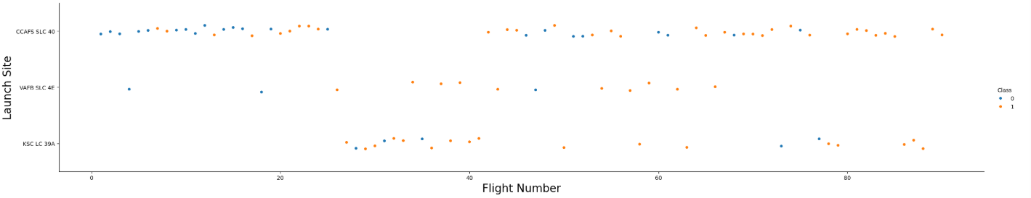
Flight Number vs. Launch Site
The number of launches from CCAFS SLC 40 were the highest.
Falcon 9 launch from CCAFS SLC had achieved the greatest number of success.

Slide 19
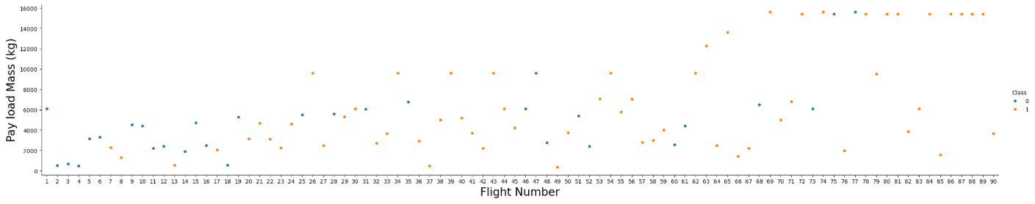
Payload vs. Launch Site
It appears that the most success happened between a 4000 and 8000 kg payload.

Slide 20
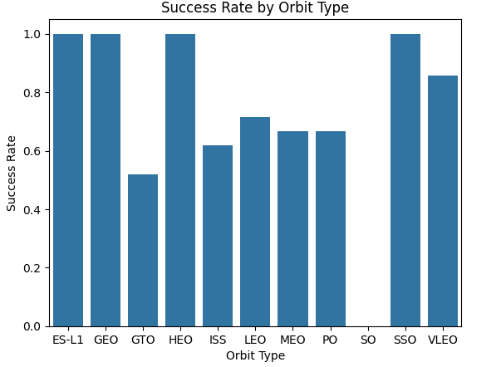
Success Rate vs. Orbit Type
ES-L1, GEO, HEO, and SSO have a 100% success rate.
SO has zero success.

Slide 21
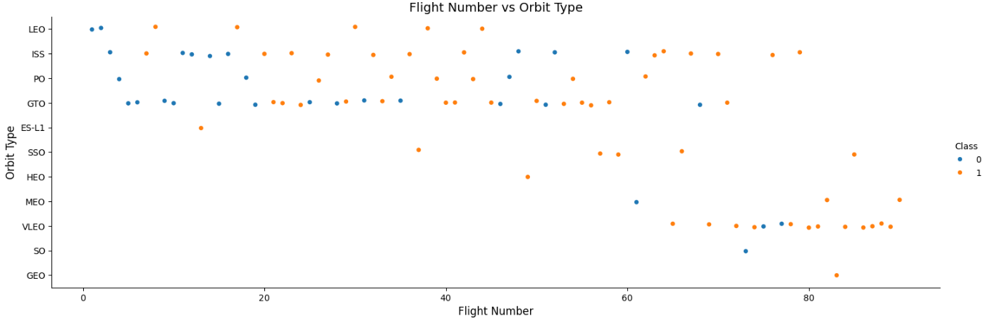
Flight Number vs. Orbit Type
GTO appears to have the best success rate across the widest amount of flight numbers.

Slide 22
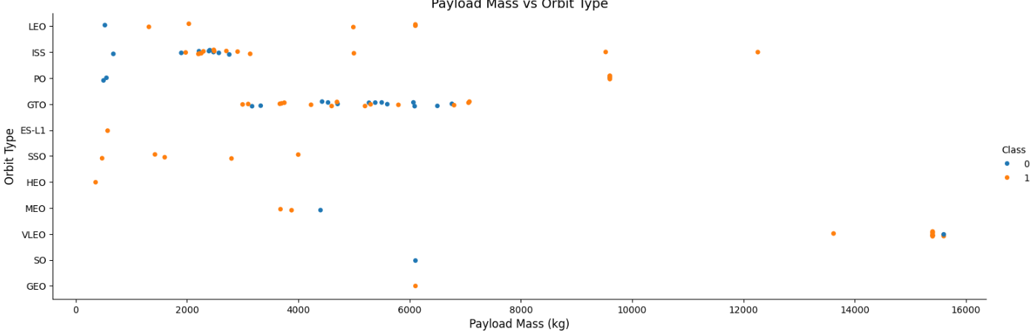
Payload vs. Orbit Type
ISS seemed to do the best between 2,000 and 3,000 kg payload
GTO had a span between 3,000 and 7,000 but seemed to have the best results between 5,000 and 6,500.

Slide 23
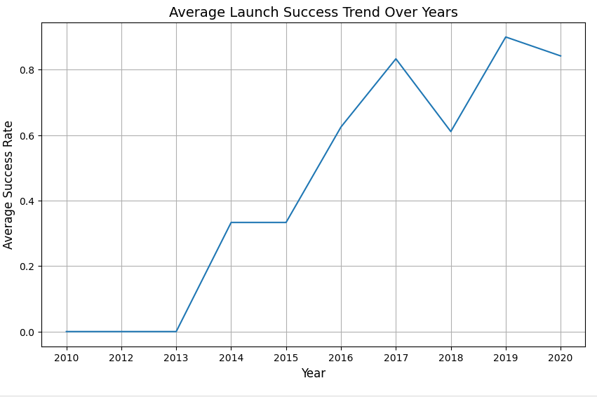
Launch Success Yearly Trend
Success rate went over 60% after 2016 with the best success happening in 2019.

Slide 24
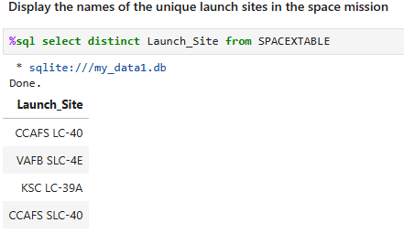
All Launch Site Names

Slide 25
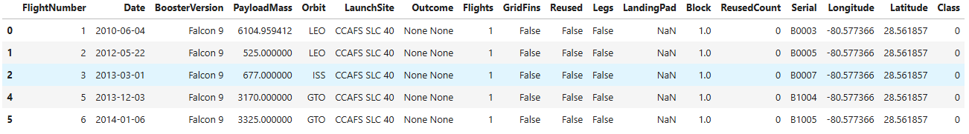
Launch Site Names Begin with 'CCA'
List of 5 launches where the Launch Site starts with CCA.

Slide 26
Total Payload Mass
Total Payload Mass for NASA: 107,010

Slide 27
Average Payload Mass by F9 v1.1
Average payload for F9 v1.1 is 2,928.4

Slide 28
First Successful Ground Landing Date

Slide 29
Successful Boosters with Payload between 4000 and 6000
F9 B4 B1040.2
F9 B4 B1040.1
F9 B5 B1046.2
F9 B5 B1047.2
F9 B5 B1048.3
F9 B5 B1051.2
F9 B5 B1058.2
F9 B5B1060.1
F9 B5B1062.1
F9 FT B1021.2
F9 FT B1031.2
F9 FT B1032.2
F9 FT B1020
F9 FT B1022
F9 FT B1026
F9 FT B1030
F9 FT B1032.1
F9 v1.1
F9 v1.1 B1011
F9 v1.1 B1014
F9 v1.1 B1016
Boosters with success on a payload between 4000 and 6000

Slide 30
Total Number of Successful and Failure Mission Outcomes
Mission_Outcome | Total
Failure (in flight) | 1
Success | 100

Slide 31
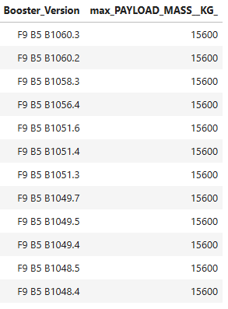
Boosters Carried Maximum Payload

Slide 32
2015 Launch Records

Slide 33
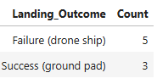
Rank Landing Outcomes Between 2010-06-04 and 2017-03-20

Slide 34

Section 3

Slide 35
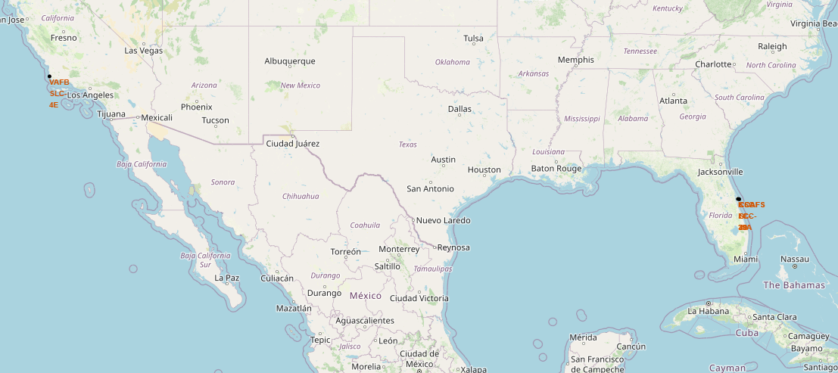
Launch Sites

Slide 36
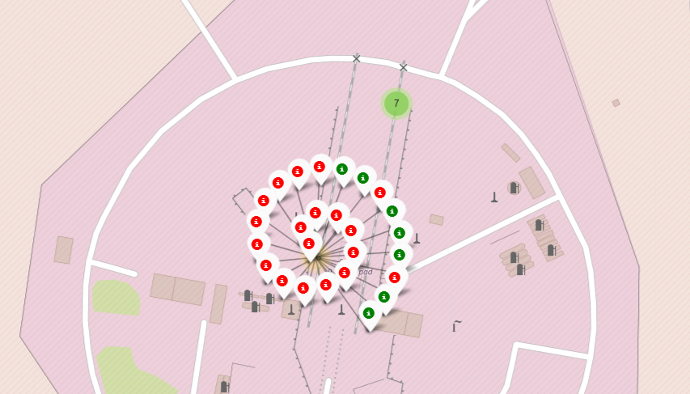
Launch Outcomes

Slide 37
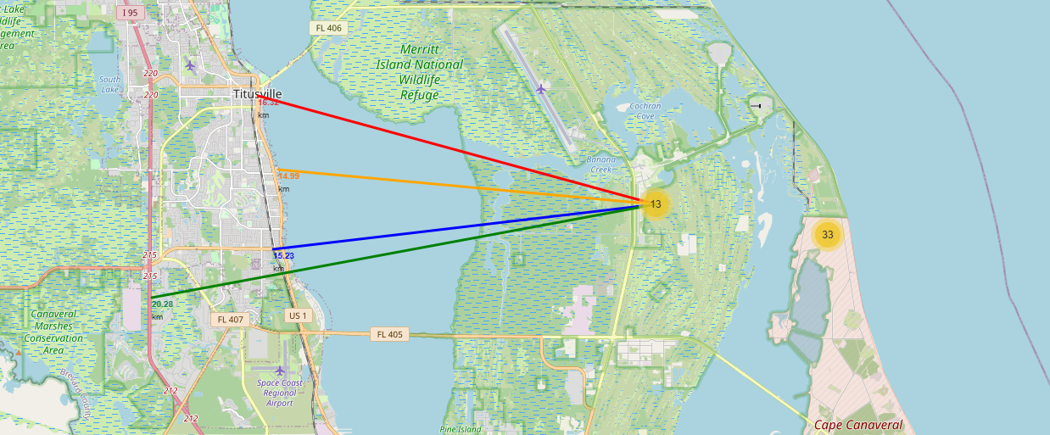
Distance to City, Railroad, and Highway

Slide 38

Section 4

Slide 39
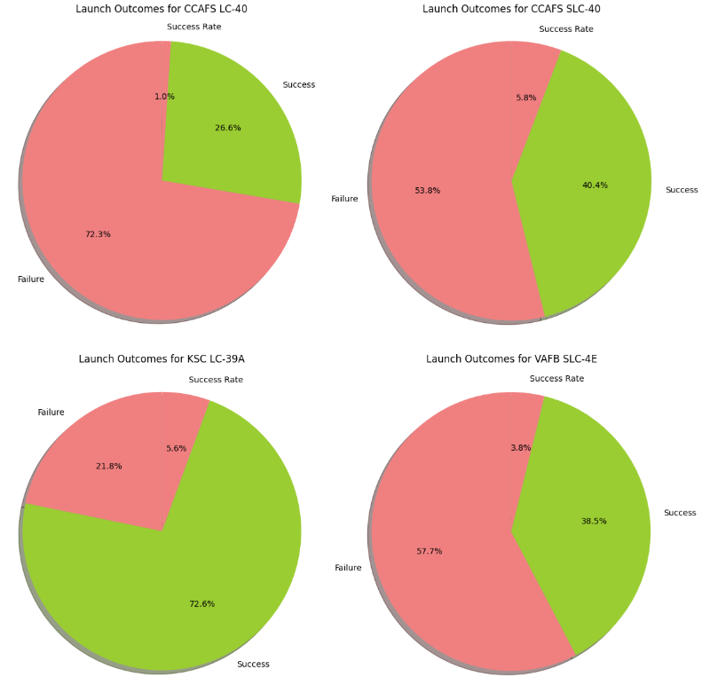
Launch Outcomes by Site
KSC LC-39A is the most successful launch site.

Slide 40
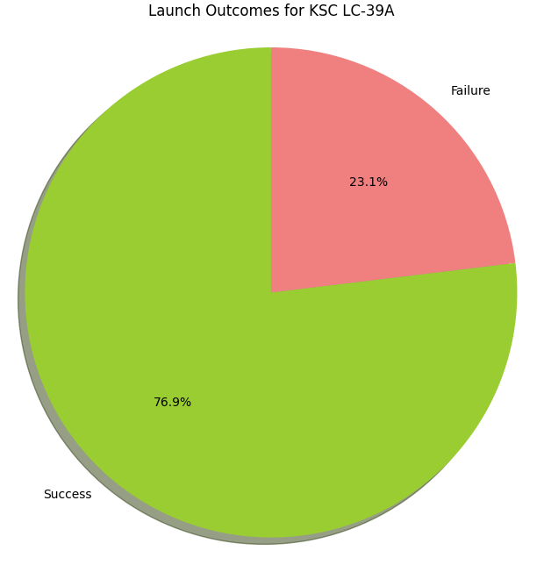
Launch Outcomes for KSC LC-39A

Slide 41
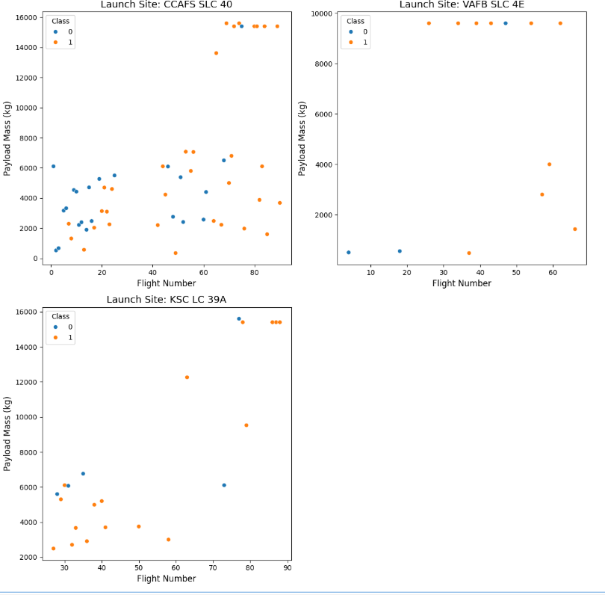
Payload vs Outcomes by flight number
CCAFS SLC 40 has the most success between 0 to 6000 payload.

Slide 42

Section 5

Slide 43
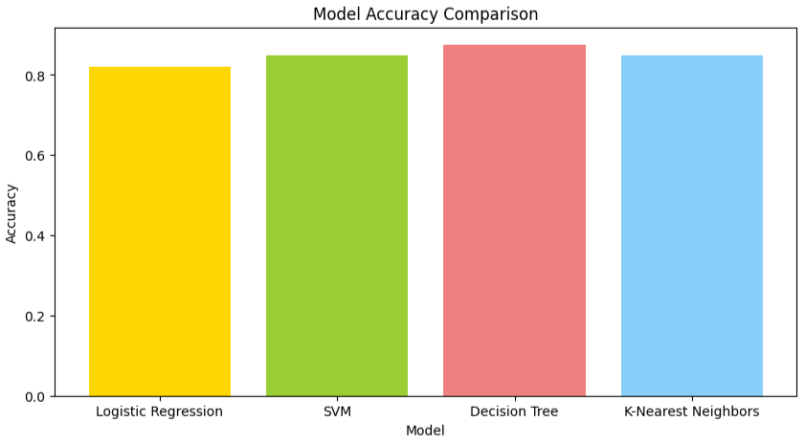
Classification Accuracy
Decision Tree has the best accuracy.

Slide 44
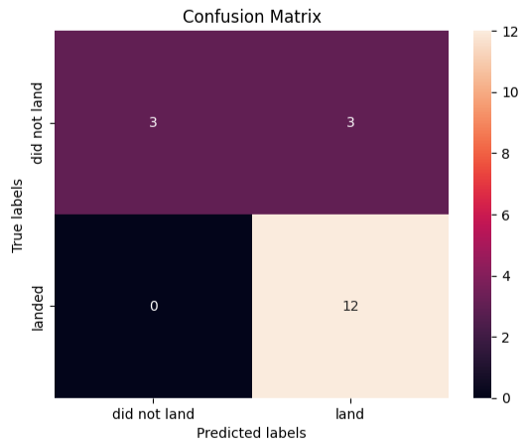
Confusion Matrix
Decision Tree has a low number of false positives.

Slide 45
Conclusions
In conclusion, this project demonstrated the feasibility of predicting Falcon 9 first stage landings using machine learning techniques. Logistic Regression and Decision Tree models achieved the highest accuracy, both at 87.5%. Exploratory data analysis highlighted the importance of factors such as flight number and payload mass in determining landing success. Accurate landing predictions can aid in cost estimation and risk assessment for space missions, ultimately impacting the economic viability of space exploration. While this study provides valuable insights, future work should focus on incorporating additional data sources, exploring advanced modeling techniques, and expanding the scope to other space-related applications

Slide 46
Appendix
Include any relevant assets like Python code snippets, SQL queries, charts, Notebook outputs, or data sets that you may have created during this project

Slide 47


